Slide 1

Capstone Project
Fault-Tolerant Distributed Big Data Processing Framework with Adaptive Workload Scheduling in Banking
Team no.
CSA15 – Cloud computing and Big Data analytics
Students Name
DHANANJAI.T-192525081
YAMEEULLAH-192525350
THIRU KUMARAN-192521149
LOKESH N-192525237
FAHIMUDDEEN-192521239
Institute of SIMATS Engineering
Guided By
Dr.A.M.Arul Raj
Professor
Institute of SIMATS Engineering
1

Slide 2
Abstract
Banks produce huge transaction data daily
Node failures delay critical banking jobs
Static scheduling overloads some nodes
Proposed: fault-tolerant distributed framework
Adaptive scheduling using node load and job priority
Data replication and automatic task recovery
Outcome: reliable, scalable banking analytics on cloud
2

Slide 3
Aim and Objective
Aim: reliable, adaptive big data processing for banks
Process large banking data on cloud clusters
Replicate data to avoid loss on node failure
Detect failed nodes and recover tasks automatically
Schedule jobs by priority and node load
Show job status and node health on a dashboard
3

Slide 4
Introduction
Banking data: transactions, accounts, logs
Needs fast, reliable, parallel processing
Distributed frameworks split work across nodes
Cloud gives scalable computing resources
Failures are common in large clusters
Adaptive scheduling balances load across nodes
4

Slide 5
Literature Review & Requirement Analysis
S.No | Year of Publication | Author | Title of the Journal / book | Methodology used | Algorithm used | Key Findings
1 | 2004 | J. Dean, S. Ghemawat | MapReduce: Simplified Data Processing on Large Clusters (OSDI) | Parallel map and reduce tasks on commodity clusters | MapReduce | Simple parallel model; failed tasks are re-executed automatically
2 | 2010 | K. Shvachko, H. Kuang, S. Radia, R. Chansler | The Hadoop Distributed File System (IEEE MSST) | Block-based storage with NameNode and DataNodes | Block replication | Data survives node failures through copies on several nodes
3 | 2012 | M. Zaharia et al. | Resilient Distributed Datasets: A Fault-Tolerant Abstraction for In-Memory Cluster Computing (NSDI) | In-memory cluster computing | RDD lineage-based recovery | Fast recovery without full data replication
5

Slide 6
Problem Statement
Banking data is huge and grows fast
Node failures delay or stop critical jobs
Common schedulers use fixed fairness or capacity rules
Live node load and job priority are not used together
Need: fault tolerance and adaptive scheduling in one framework
7

Slide 7
Existing System
Hadoop MapReduce with HDFS block replication
Spark with RDD lineage-based recovery
YARN with fair and capacity schedulers
Limitation: scheduling ignores live node load and job priority
Limitation: urgent jobs such as fraud checks may wait in queue
Limitation: fault recovery is handled separately from scheduling
8

Slide 8
Proposed System
Distributed big data framework for banking workloads.
Data split into partitions with replicas on many nodes.
Adaptive scheduler uses node load and job priority.
Heartbeat monitor detects failed nodes.
Lost tasks rerun on healthy nodes automatically.
Dashboard shows job status and node health.
9

Slide 9
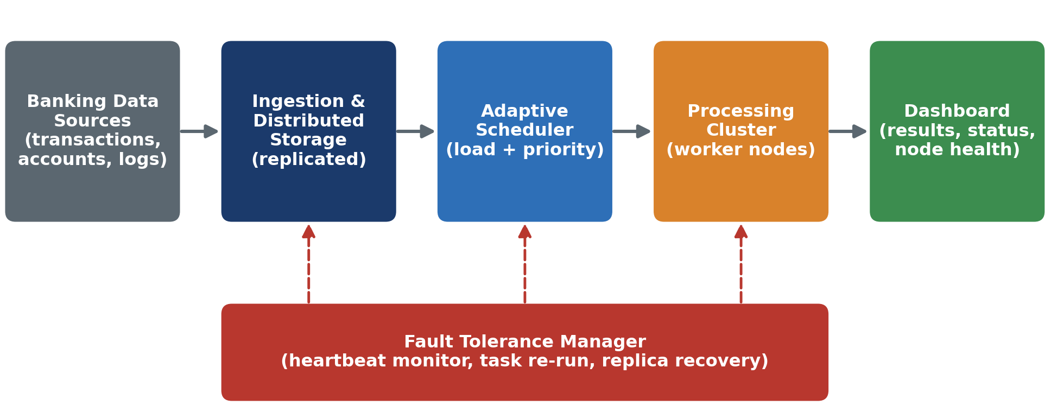
Overall System Architectural Design
Replication and recovery solve node failure
Adaptive scheduler solves uneven node load
10

Slide 10


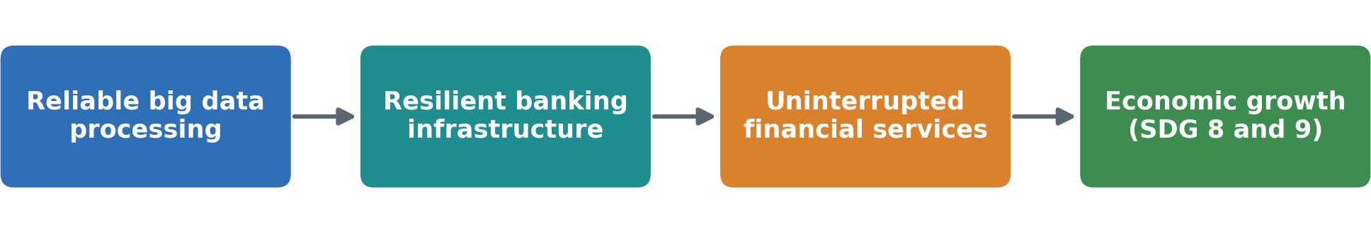
Sustainable Development Goal (SDG) Implementation
Selected SDG 9: Industry, Innovation and Infrastructure
Resilient digital banking infrastructure
Reliable data processing keeps financial services running
Also supports SDG 8: Decent Work and Economic Growth
11

Slide 11
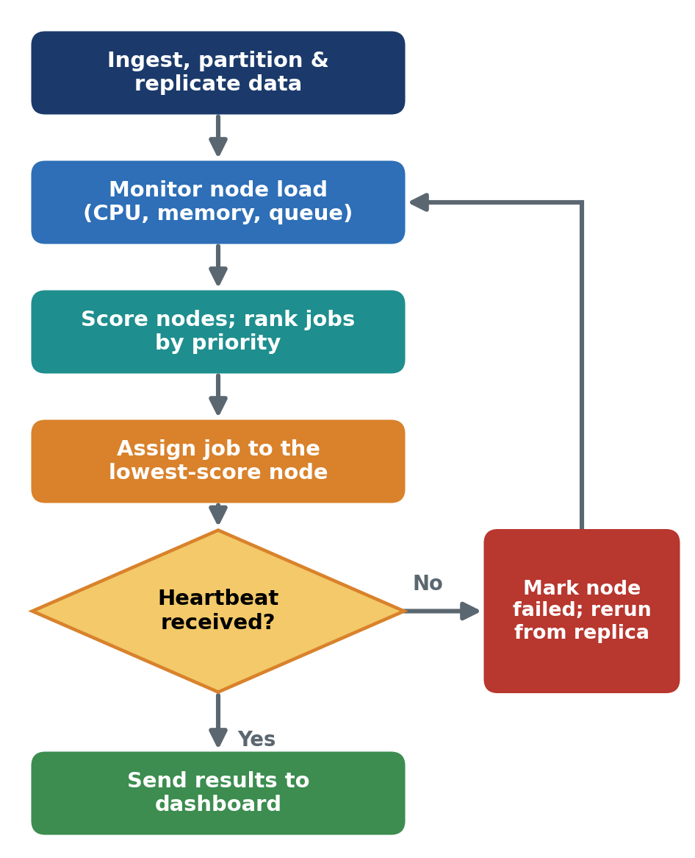
Proposed Methodology and Algorithm
Algorithm: Adaptive Load-Aware Priority Scheduling.
Node score = weighted CPU, memory, queue load.
Jobs ordered by priority, then waiting time.
Task goes to the lowest-score node.
Missed heartbeat marks node as failed.
Failed tasks rerun; data read from replicas.
12

Slide 12

Design & Module Planning
Module 1: Data Ingestion and Storage
Module 2: Resource Monitoring
Module 3: Adaptive Workload Scheduling
Module 4: Fault Detection and Recovery
Module 5: Analytics and Dashboard
13

Slide 13
Module 1: Data Ingestion and Storage
Purpose: bring banking data into the cluster safely
Collects transactions, accounts, and logs (batch and streaming)
Cleans, validates, and masks sensitive data
Splits data into partitions
Stores copies (replicas) on several nodes
Output: clean, protected, replicated data
14

Slide 14
Module 2: Resource Monitoring
Purpose: know the live state of every node
Tracks CPU, memory, and queue length
Receives regular heartbeat signals
Calculates a load score for each node
Output: live load scores for the scheduler
15

Slide 15
Module 3: Adaptive Workload Scheduling
Purpose: share work evenly and serve urgent jobs first
Gives each job a priority (fraud check high, report low)
Assigns each task to the lowest-score node
Rebalances tasks when load changes
Adds or removes cloud nodes as demand changes
Output: balanced and faster job execution
16

Slide 16
Module 4: Fault Detection and Recovery
Purpose: keep jobs running when nodes fail
Detects missed heartbeats and marks the node as failed
Reruns lost tasks on healthy nodes
Restores data from replicas and checkpoints
Output: no data loss and jobs still finish
17

Slide 17
Module 5: Analytics and Dashboard
Purpose: turn processed data into useful results
Runs analytics such as fraud detection and risk reports
Shows job status and node health
Displays results to bank staff
Output: clear and quick insights for decisions
18

Slide 18
Conclusion
Fault-tolerant distributed framework designed for banking
Replication and recovery prevent data and job loss
Adaptive scheduling balances load; urgent jobs run first
Cloud scalability supports growing banking data
Future work: ML load prediction, stronger security, multi-cloud
19

Slide 19
References
[1] J. Dean and S. Ghemawat, “MapReduce: Simplified Data Processing on Large Clusters,” OSDI, 2004.
[2] K. Shvachko, H. Kuang, S. Radia, and R. Chansler, “The Hadoop Distributed File System,” IEEE MSST, 2010.
[3] M. Zaharia et al., “Resilient Distributed Datasets: A Fault-Tolerant Abstraction for In-Memory Cluster Computing,” USENIX NSDI, 2012.
[4] M. Zaharia, A. Konwinski, A. D. Joseph, R. Katz, and I. Stoica, “Improving MapReduce Performance in Heterogeneous Environments,” OSDI, 2008.
[5] M. Zaharia et al., “Delay Scheduling: A Simple Technique for Achieving Locality and Fairness in Cluster Scheduling,” EuroSys, 2010.
[6] V. K. Vavilapalli et al., “Apache Hadoop YARN: Yet Another Resource Negotiator,” ACM SoCC, 2013.
20

